Slide 1
Integrated Assessment Models: Interaction Economy, GHGs, and Climate
Economy
GHG-emissions
Climate
change
Damage
What does each component look like in an Integrated Assessment Model? (For example DICE)

Slide 2
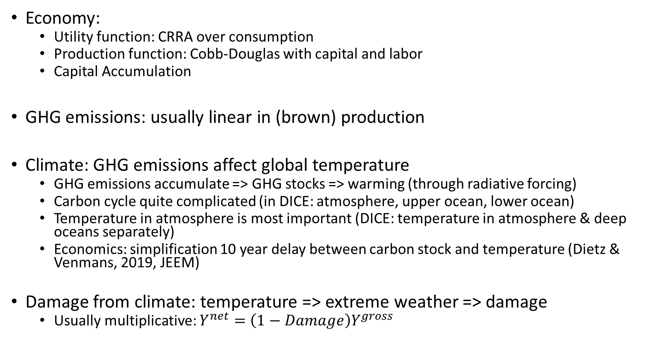
Components of IAM
Economy:
Utility function: CRRA over consumption
Production function: Cobb-Douglas with capital and labor
Capital Accumulation
GHG emissions: usually linear in (brown) production
Climate: GHG emissions affect global temperature
GHG emissions accumulate => GHG stocks => warming (through radiative forcing)
Carbon cycle quite complicated (in DICE: atmosphere, upper ocean, lower ocean)
Temperature in atmosphere is most important (DICE: temperature in atmosphere & deep oceans separately)
Economics: simplification 10 year delay between carbon stock and temperature (Dietz & Venmans, 2019, JEEM)
Damage from climate: temperature => extreme weather => damage
Usually multiplicative: $Y^{net}=\left(1−Damage\right)Y^{gross}$

Slide 3
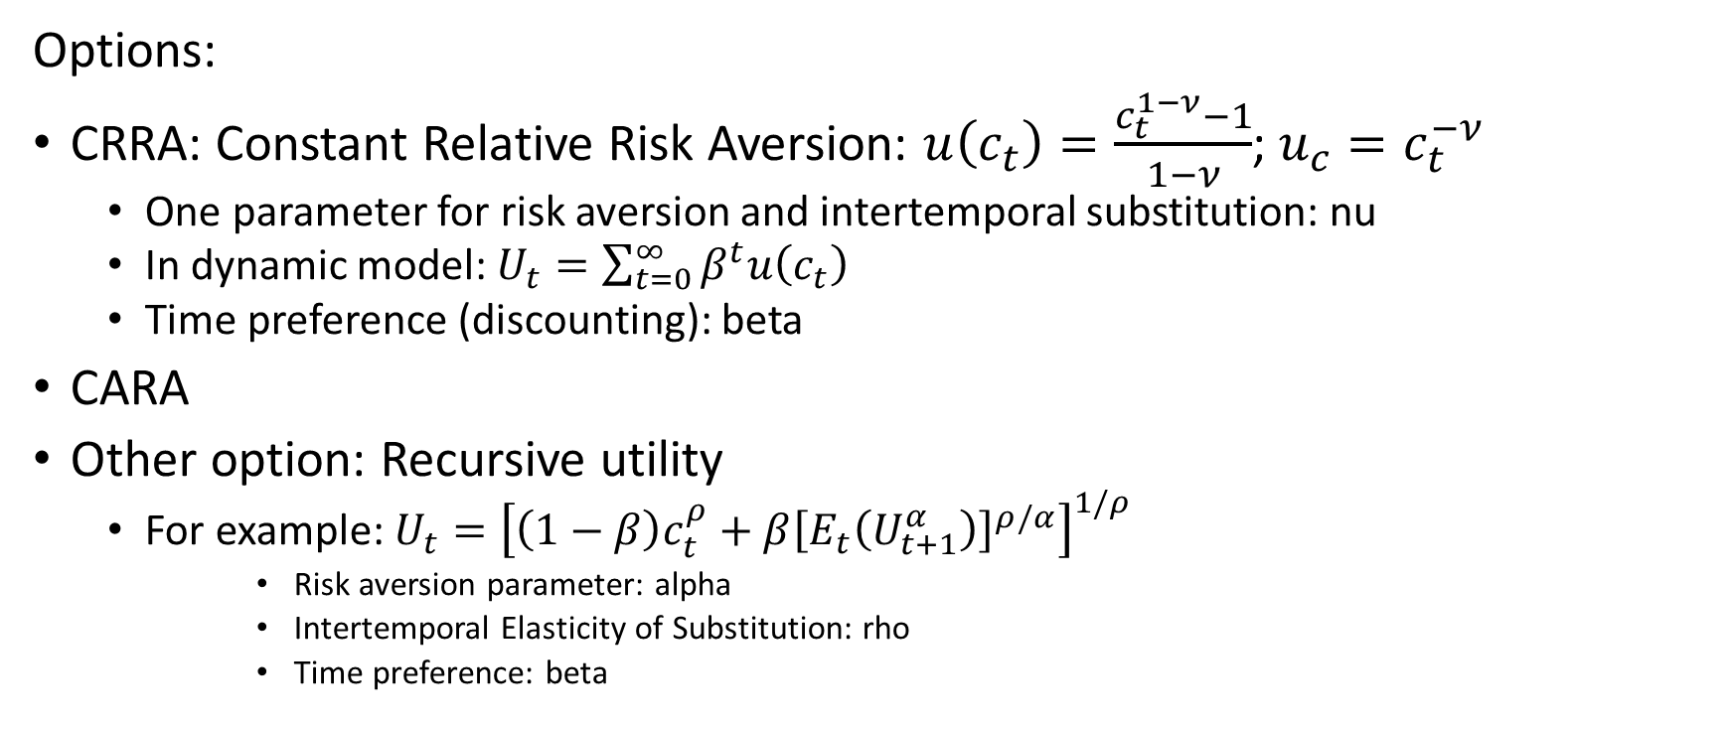
Utility function (concave)
Options:
CRRA: Constant Relative Risk Aversion: $u\left(c_{t}\right)=\frac{c_{t}^{1−ν}−1}{1−ν}$; $u_{c}=c_{t}^{−ν}$
One parameter for risk aversion and intertemporal substitution: nu
In dynamic model: $U_{t}=\sum_{t=0}^{∞}{β^{t}u\left(c_{t}\right)}$
Time preference (discounting): beta
CARA
Other option: Recursive utility
For example: $U_{t}={\left[{\left(1−β\right)c}_{t}^{ρ}+β{\left[E_{t}\left(U_{t+1}^{α}\right)\right]}^{ρ/α}\right]}^{1/ρ}$
Risk aversion parameter: alpha
Intertemporal Elasticity of Substitution: rho
Time preference: beta

Slide 4
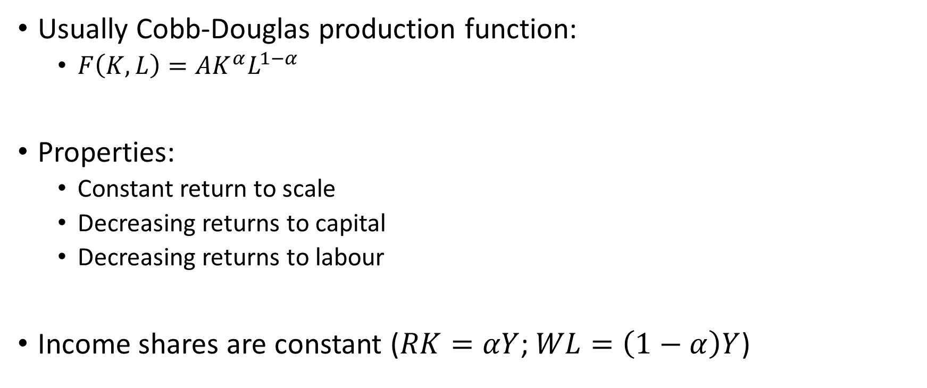
Production
Usually Cobb-Douglas production function:
$F\left(K,L\right)=AK^{α}L^{1−α}$
Properties:
Constant return to scale
Decreasing returns to capital
Decreasing returns to labour
Income shares are constant ($RK=αY$; $WL=\left(1−α\right)Y$)

Slide 5
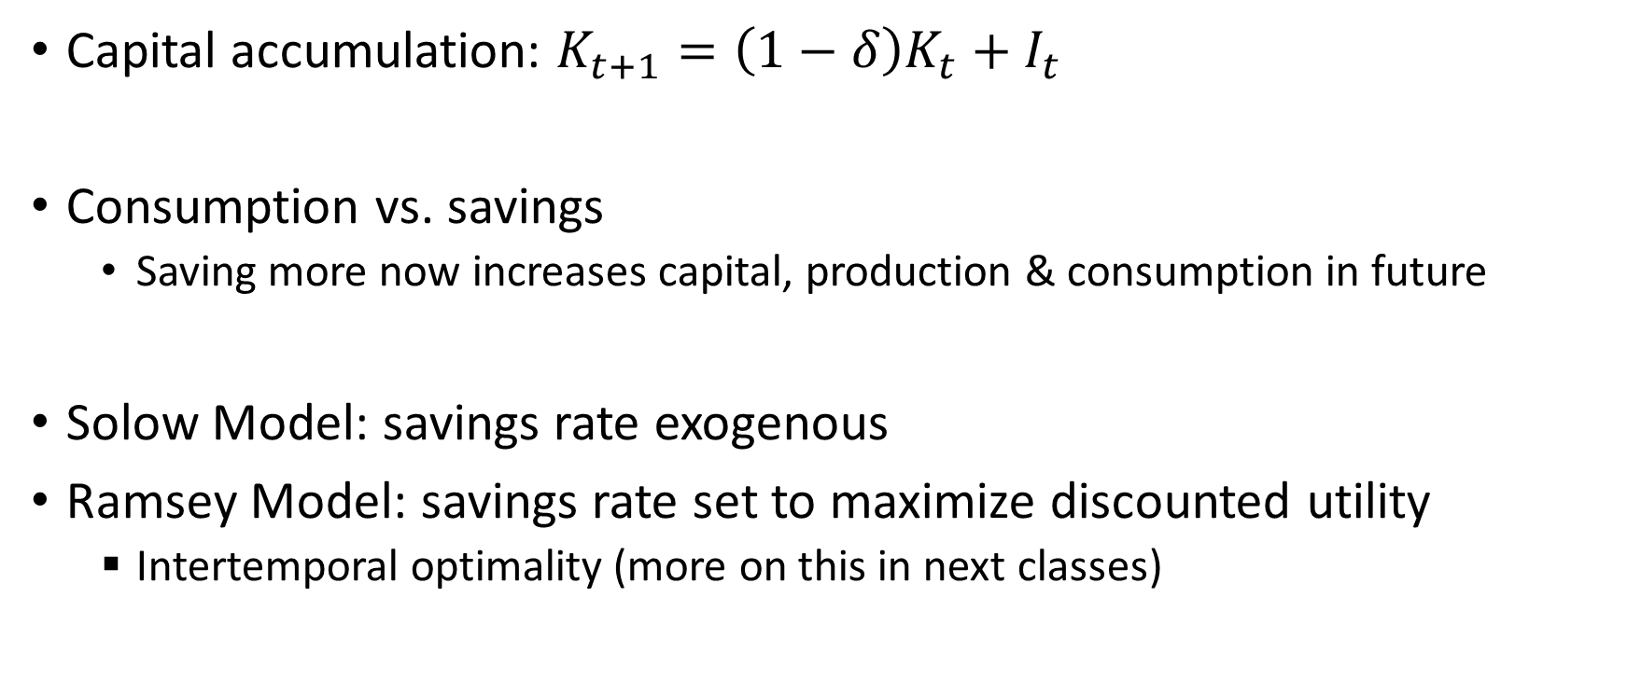
Capital Accumulation
Capital accumulation: $K_{t+1}=\left(1−δ\right)K_{t}+I_{t}$
Consumption vs. savings
Saving more now increases capital, production & consumption in future
Solow Model: savings rate exogenous
Ramsey Model: savings rate set to maximize discounted utility
Intertemporal optimality (more on this in next classes)

Slide 6
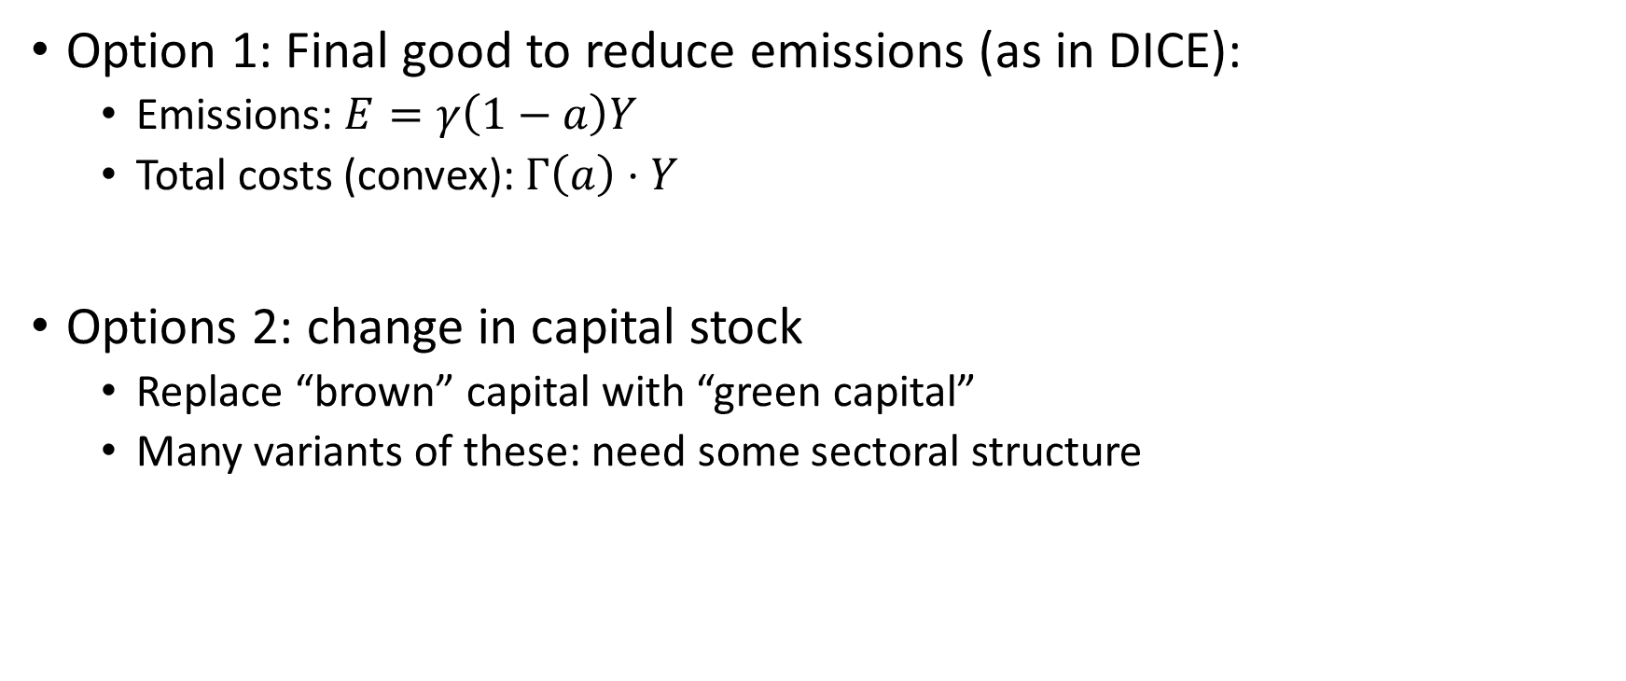
Abatement: reducing GHG emissions
Option 1: Final good to reduce emissions (as in DICE):
Emissions: $E=γ\left(1−a\right)Y$
Total costs (convex): $Γ\left(a\right)⋅Y$
Options 2: change in capital stock
Replace “brown” capital with “green capital”
Many variants of these: need some sectoral structure

